Slide 1
Bryan Mackenzie
Gesture Training

Slide 2
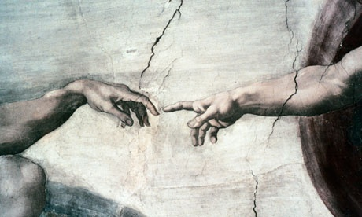
Gesture Training: Agenda
Module Structure
Overview
Hand Module
Structure
Initialization
Processing Loop
Hand Configuration
General
Gestures
Tracking
Alerts
Hand Output
General
Hand data
Joint data
Finger data
Extremity Points
Hand Event handlers
Implementation
Callback
Polling
Hand Tracking Modes
Polling Skeletal
Gesture
Blob Module
Structure
Configuration
Initialization
Processing Loop

Slide 3
User Experience Design
User Experience Design ≠ User Interface Design

Slide 4
User Experience Design
Feedback
When the gestures is recognized, is there visual indication of an action on behalf of the users command? It is important that there always be a connection between actions and results. If a video is click, it plays. If a button is selected it should animates and initiate the desired action (page load, data submission, etc.)
*Ask yourself: Does the feedback mechanism make sense? Does it detract from the action or task?
First iteration: Too many false positive results, not visual feedback to the user. This approach was prone to
Initiate a swipe when it was not the intent of the user (Video)
Second iteration: issue with static feedback on the top right of the page was used to indicate to
the user successful interactions. The problem… when interacting with web pages, the user is looking at the
content, not a visual box indicating they are interacting with content. (Video)
Third Iteration: Dynamic approach showing the user where they are and having content react to
interaction. This gives the user real-time feedback on successful navigation and interaction. (Live Demo)
Case Study: Crafting a good user experience
Notes:
First Iteration:
The idea of swipe for instance it to move your hand from one side to another. If you’ve seen user
Testing. It quickly becomes apparent that swiping quickly, slowly, holding the hand at the end of the
Swipe or quickly moving your hand back (back swipe) are issues that need to be resolved.
- Latest Demo: http://realsense.sni.foodnetwork.com/
First iteration: Too many false positive results, not visual feedback to the user.
Video
Second iteration: issue with static feedback on the top right of the page was used to indicate to the user successful interactions. The problem… when interacting with web pages, the user is looking at the content, not a visual box indicating they are interacting with content.
Video
Third Iteration: Dynamic approach showing the user where they are and having content react to interaction. This gives the user real-time feedback on successful navigation and interaction.
Live Demo - Latest Demo: http://realsense.sni.foodnetwork.com/

Slide 5
User Experience Design
Forgiveness
Understanding the limitations of tracking, we can better design with forgiveness in mind to create better experiences.
*Ask yourself: Can the end-user easily make mistaken? How easily can one recover from a mistake?
Does the design require finer granular or course movements for interaction?
If there are large buttons, why use 22 joints when a single blob extremity point will suffice.
Could it be done better with another form of input?
Perhaps joint, blob, speech input? You wouldn’t want to have speech scroll (repeatedly saying scroll)
Does the gesture correlate to another action?
It shouldn’t, clicking to open should not click to rotate in the sample application. Design for forgiveness!
How easily can the user make a mistake?
People tend to touch their face an average of 4 times an hours, be mindful of these actions.
A few things to consider in your gesture integration
Notes:
Forgiveness
Understanding the limitations of tracking, we can better design with forgiveness in mind to create better experiences.
But what is Forgiveness in terms of interaction: When users think they did one thing but "really" did something else. They believe that they click yes, but in reality they click no. Due to difficult navigation, poor input design, etc.
Forgiveness is a well established principal, take the mouse click as an example, if buttons are close and in clusters there is a increased chance of clicking on an undesired button option
In the case of clicking, we solve this by giving a generous click zone…for gestures, think about the design and how to avoid false positives and unintended outcomes.
Does the design require finer granular or course movements for interaction?
If there are large buttons, why use 22 joints when a single blob extremity point will suffice.
Could it be done better with another form of input?
Perhaps joint, blob, speech input? You wouldn’t want to have speech scroll (repeatedly saying scroll)
Does the gesture correlate to another action?
It shouldn’t, clicking to open should not click to rotate in the sample application.
You wouldn’t remap mouse keys for word!
Does the gesture correlate to another action?
It shouldn’t, clicking to open should not click to rotate in the sample application.
*Navigator Demo and discussion on forgiveness.

Slide 6
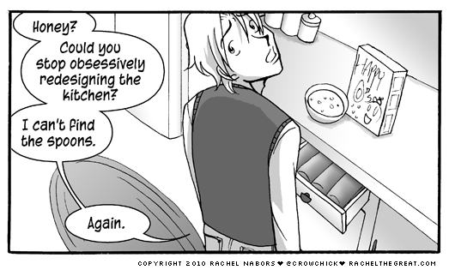
User Experience Design
Consistency and User Expectation
Why not come up with a radical new design?
Consistency makes it easier for end-users to adopt and learn new tools, but why is that so important?
It is important because humans are great at pattern recognition. When there is deviation from a familiar
pattern, it requires reevaluation, which requires Cognitive Energy…additional time is spent thinking about
how to interact as opposed to complete the task at hand. This is coupled with expectation. As illustrated
above, user become comfortable and expect certain things to remain largely the same.
Notes:
Consistency
Navigation and consistency. I was recently asked by a large web developer about a standard for web based navigation using gestures. The concern is that with each developer a new navigation model will be introduced. Leaving users to relearn simple tasks such as a page scroll….does this make sense…no.

Slide 7

User Experience Design
Reliability
To provide a reliable experience we must implement and integrate gestures that compensate for failure.
*Ask yourself: Is my design bulletproof?
Drag over 30 Frames
Consecutive checks to
determine if pinch has
in fact been lost
Pinch lost due to speed
Notes:
To provide a reliable experience we must implement and integrate gestures that compensate for failure.
Click
In it’s current state gestures have a bad reputation for being unreliable…how do we fix this? Here one example of design with failure in mind for reliability.
Take for example pinch and drag loss vs speed. When designing a pinch and drag, fast movements are lost. We do not want the user to experience this...So how do we hide the lose and provide a reliable experience? Moreover, the users intended action must result in the expected outcome, if not a sense of control is lost.
*Ask yourself: Is my design bulletproof? If you can answer…No, but I’ve done everything possible to mitigate error your on the right track. Understandingthe limitations, helps design better functional interaction.

Slide 8
User Experience Design
Usability
How “intuitive” or “natural’ are the gestures to perform?
Do they make sense within the current context?
There is an application that requires a user to make a peace sign to fire missiles…
Example: For Food network we implemented two methods for scrolling “hold and hover” and “Zone triggered variable speed hovering”
show a video of the two in actions
What makes hold and hover less “natural” and the weaker of the two options?
Holding and hovering with a delay means there is a delayed response to the actions.
Hold a static pose is far less comfortable than completing a simple movement and gaining the response. There is the added benefit to the zone triggered variable speed hovering engaging the user further in the interaction by providing “more control”.
Notes:
When users think they did one thing but "really" did something else, they lose their sense of controlling the system because they don't understand the connection between actions and results. The user experience feels random and definitely not empowering.

Slide 9
Module Structure

Slide 10
Module Structure
PXCModule
CreateActiveConfiguration
CreateOutput
Module
PXCModuleConfiguration
ApplyChanges
Update
Dispose
RestoreDefaults
PXCModuleData
Update
QueryxxxData
Output
Configuration
Notes:
Every module consists of the following basic blocks:
The PXCModule is the interface which provides member functions to do tracking and recognition.
The PXCModuleConfiguration is an interface which provides member functions to configure the tracking module
The PXCModuleData is the interface manages the module output data
PXCModule:
CreateActiveConfiguation: This can be called multiple times to allow different settings for various app stages
CreateOutput: This can be called multiple times to store past results
PXCModuleConfiguration:
ApplyChanges: Updates the configuration parameters, must be called in order for configuration changes to be stored. Multiple instances instance of the configuration can be created and alternated, by called ApplyChanges.
Update: Updates the configuration parameters to the latest available.
RestoreDefaults: Restores the configuration parameters to their original default values.
PXCModuleData:
Update: This function retrieves the latest most up-to-date available output data. Multiple Instances can be used to store different results/events, or to calculate changes over time.

Slide 11
Hand Module

Slide 12
Hand Module Structure
PXCHandData
Update
QueryNumberOfHands
QueryHandData
QueryFiredAlertData
QueryFiredGestureData
…
PXCSenseManager
CreateInstance
EnableHand
QueryHand (returns hand module instance)
Init (initialize pipeline)
Stream / Acquire / Release
PXCHandModule
CreateActiveConfiguration
CreateOutput
PXCHandConfiguration
ApplyChanges
Update
Dispose
SetUserName
SetTrackingMode
SetTrackingBounds
EnableNormalizedJoints
EnableAlert
EnableGesture
IHand
QueryUniqueId
IsCalibrated
QueryTrackedJoint
QueryFingerData
QuerySegmentationImage
…
Notes:
Every module consists of the following basic block:
The Core Module is the interface which provides member functions to do tracking and recognition.
The Configuration module is an interface which provides member functions to configure the tracking module
The data module which is the interface manages the module output data
A brief look at the pipeline:
PXCSenseManager: Is a helper interface to common SDK functionality such has the hand module, face module and so on.
PXCHandConfiguration: is the interface provides member functions used to configure the hand tracking module
PXCHandModule: is an interface that provides member functions to perform hand tracking and gesture recognition.
PXCHandData: is the interface which handles the hand tracking module output data.
PXCMHandData.IHand: is the interface which manages the tracked hand data
PXCModule:
CreateActiveConfiguation: This can be called multiple times to allow different settings for various app stages
CreateOutput: This can be called multiple times to store past results
PXCModuleConfiguration:
ApplyChanges: Updates the configuration parameters, must be called in order for configuration changes to be stored. Multiple instances instance of the configuration can be created and alternated, by called ApplyChanges.
Update: Updates the configuration parameters to the latest available.
RestoreDefaults: Restores the configuration parameters to their original default values.
PXCModuleData:
Update: This function retrieves the latest most up-to-date available output data. Multiple Instances can be used to store different results/events, or to calculate changes over time.

Slide 13
Hand Module Setup
PXCSenseManager CreateInstance ()
Initialization
PXCSenseManager
EnableHand ()
QueryHand ()
Init()
PXCHandModule
CreateOutput ()
PXCHandData
AcquireFrame()
Processing
Update ()
QueryHandData ()
PXCHandData.IHand
PXCHandData
Update Hand data
Store hand data
Manage data
ReleaseFrame ()
Notes:
Click
Initialization:
The CreateInstance creates an instance of the PXCMSenseManager interface, which the interface to the SDK processing modules.
Calling EnableHand activates the PXCMHandModule in the pipeline.
Calling QueryHand returns the PXCMHandModule instance, which handles tracking and gesture recognition.
Using the PXCMHandModule instance we then call CreateOutput, which returns an new instance of PXCMHandData, which is used to store and retrieve hand module data.
Calling Init initializes the SDK pipeline.
Processing Loop:
Using the PXCMSenseManager instance you call AcquireFrame once the frame has signaled success
We call Update on the handData instance, which updates the output data to the latest available.
Calling QuertHandData enumerates the detected hands data, which is stored in Ihand.
The we release the frame, so that we can grab the next frame.
Initialization
Create session instance
Enabled hand tracking
Query and return and instance of the handModule
Create an instance of the output data storage. Returns an instance of handData
Initialize the pipeline
Processing
Acquire the frame
Update to the latest data
Query and store the latest hand data
Ihand instance then used to query hand specific data for the capture hand data
Release the frame

Slide 14
Hand Module Initialization
void Start ()
{
/* Initialize a PXCMSenseManager instance */
sm = PXCMSenseManager.CreateInstance ();
if (sm == null)return;
/* Enable hand module */
pxcmStatus sts = sm.EnableHand ();
/* Configuration the hand and subscribe to gestures and alerts */
hcfg = hand.CreateActiveConfiguration ();
hcfg.EnableAllGestures ();
hcfg.EnableAllAlerts ();
hcfg.SubscribeGesture (OnFiredGesture);
hcfg.SubscribeAlert (OnFiredAlert);
hcfg.ApplyChanges ();
hand = sm.QueryHand(); // Create PXCMHandModule instance from PXCMSenseManager instance
if (hand == null) return;
handData = hand.CreateOutput(); // Create PXCMHandData instance from PXCMHandModule instance
/* Initialize the execution pipeline */
sts = sm.Init ();
if (sts < pxcmStatus.PXCM_STATUS_NO_ERROR)
{
OnDisable ();
return;
}
}
Initialization:
Create a Sense Manager instance
Enable the hand module
Configure hand tracking options
Query hand module instance
Query hand data instance
Initialize the execution pipeline

Slide 15
Hand Module Processing Loop
void Update()
{
/* Make sure SenseManager Instance is valid */
if (sm == null) return;
/* Wait until any frame data is available */
if (sm.AcquireFrame(false, 0) != pxcmStatus.PXCM_STATUS_NO_ERROR) return;
if (handAnalyzer != null)
{
handData.Update();
/* Retrieve all joint Data */
for (int i = 0; i < handData.QueryNumberOfHands(); i++)
{
PXCMHandData.IHand iHand;
if (_handData.QueryHandData(PXCMHandData.AccessOrderType.ACCESS_ORDER_FIXED, i, out iHand) == pxcmStatus.PXCM_STATUS_NO_ERROR)
{
_iHand.QueryTrackedJoint((PXCMHandData.JointType)j, out jointData[i][j]);
}
}
DisplayJoints();
handData.Dispose();
}
handAnalyzer.Dispose();
sm.ReleaseFrame();
}
Every frame:
Acquire the frame
Update the hand data
Query the data (stored in IHand)
Process the data
Release the frame
Notes:
This is how we access the hand data, every frame:
Update and capture the new frame
Retrieve the hand module instance
Retrieve the hand data instance
Update the hand data
And Query various hand items and process the data.

Slide 16
Hand Module: Acquire a Frame
/* Wait until any frame data is available */
if (sm.AcquireFrame(false, 0) != pxcmStatus.PXCM_STATUS_NO_ERROR) return;
Functions | Description
AcquireFrame(true) | Blocks until all modules have completed on the current frame (locks to lowest frequency)
AcquireFrame(true, 100) | Blocks until all modules have completed on the current frame or the timeout is reached
AcquireFrame(false) | Blocks until one of the modules has signaled that it’s processing is complete
AcquireFrame(false, 0) | Checks the current module running status and returns immediately
StreamFrames(true) | implements the Acquire / Release loop in a separate thread, blocks until loop exits
StreamFrames(false) | implements the Acquire / Release loop in a separate thread, returns immediately
1
2
Notes:
It is important to understand how the application will process frames. Depending on whether the application requires a high frame rate and what modules the application will be using is the determining factor for the acquire frame parameters.
Take for example, a Unity application: If the applications uses true, the main processing thread will be block, the main thread is where the game logic is housed, so the application will become un responsive until the modules have signaled success.

Slide 17


Hand Module: Hand Access Order
Common Approach:
Determine the number of hands in frame
Retrieve the hand data based on access orders of detected hands
for (int i = 0; i < _handData.QueryNumberOfHands(); i++)
{
PXCMHandData.IHand _iHand;
if (_handData.QueryHandData(PXCMHandData.AccessOrderType.ACCESS_ORDER_NEAR_TO_FAR, i, out _iHand) == pxcmStatus.PXCM_STATUS_NO_ERROR)
{
...
}
}
Access order type | Description
ACCESS_ORDER_BY_TIME | Order by the oldest to newest in the scene
ACCESS_ORDER_NEAR_TO_FAR | Order from nearest to furthers
ACCESS_ORDER_LEFT_HANDS | Only returns left hands
ACCESS_ORDER_RIGHT_HANDS | Only returns right hands
ACCESS_ORDER_FIXED | Fixed retrieval of hands based on consistent ID*
1
2
Notes:
Why is access order important? Well the Hand ID is consistent, so we can expect to see and IDs as 1, 2, 3, etc. Which will never change, however, the hand it refers to might. A hand will keep its ID until it hand is lost or no longer detected, the next hand detected will then get that ID. So keep a reference to the hand and specify an access order to understand what hand it is, such as with has Order_Left_Right, we know that the first hand detected is the left most hand and so on.

Slide 18
Configuration

Slide 19
Configuration: General
Typically flow of configuration:
Get instance of hand configuration
Modify configuration settings
Apply your changes
Dispose
Member Function | Description
ApplyChanges | Applies changed configuration settings
Update | Queries for the current active configuration*
Dispose | Disposes of the configuration instance*
RestoreDefaults | Restores the active configuration to default values
ResetTracking | Resets the hand tracking context
/* Configure a hand - Enable Gestures and Alerts */
PXCMHandConfiguration hcfg = handAnalyzer.CreateActiveConfiguration (); // Create an instance of PXCMHandConfiguration, used to configure hand tracking
hcfg.EnableAllGestures (); // Enable Gesture event notification
hcfg.EnableAlert (PXCMHandData.AlertType.ALERT_HAND_NOT_DETECTED); // Enable hand lost alert, either hand left the field of view or is occluded.
hcfg.ApplyChanges (); // Apply the configuration
hcfg.Dispose (); // Release the instance
Notes:
The general configuration flow is as follows:
Create and instance of the configuration interface
Modify configuration settings
Apply your changes
Dispose of the instance
ApplyChanges Applies changed configuration settings
Update Queries for the current active configuration, potential used if one is switching between configuration.
Dispose Disposes of the configuration instance. Alternative to disposing of the configuration is can be kept and used to reconfigure the hand for different modes. Perhaps such as menu and the game interaction, or alternative game levels which require slight configuration modifications.
RestoreDefaults Restores the active configuration to default values
ResetTracking Resets the hand tracking context
/* Configure a hand - Enable Gestures and Alerts */
// Create an instance of PXCMHandConfiguration, used to configure hand tracking
// Enable Gesture event notification
// Enable hand lost alert, either hand left the field of view or is occluded.
// Apply the configuration
// Dispose the instance

Slide 20
Configuration: Alerts
Member Function | Description
Enable / DisbaleAlert | Enabled / Disable specific alert notification
Enable / DisbaleAllAlerts | Enabled / Disable all alert notifications
SubscribeAlert | Register an event handler object for all alerts
IsAlertEnabled | set/retrieve the current tracking bounds frustum
Alert Types:
HandCalibrated: If there is a valid calibration on the hand
HandDetected: If there is a hand detected in the frustum
HandTracked: If there is full skeletal data available for the detected hand
HandOutofxxxxBorder: If the hand touches the tracking bounds (Left, right, bottom or Top)
HandTooclose / HandTooFar: If the hand is too close or too far from the camera
Notes:
Here we take a look at configuration properties to customize alerts
Enabled / Disable specific alert notification
Enabled / Disable all alert notifications
Register an event handler object for all alerts
set/retrieve the current tracking bounds frustum
Alert Types:
HandCalibrated: If there is a valid calibration on the hand. Use of the alert notification is to determine if there is a calibrated hand
HandDetected: If there is a hand detected in the frustum
HandTracked: If there is full skeletal data available for the detected hand. If the users hand is almost outside of the camera view frustum and whether the tracked hand has valid skeletal data.
HandOutof xxxxBorder: If the hand touches the tracking bounds (Left, right, bottom or Top)
HandTooclose / HandTooFar: If the hand is too close or too far from the camera

Slide 21
Configuration: Gestures
Member Function | Description
Enable/Disable Gestures | Enable / Disable continuous for specific gesture event notifications
Enable/Disable AllGestures | Enable / Disable continuous for all gesture event notifications
SubscribeGestures | Register an event handler object for all gestures
IsGestureEnabled | Checks to see if a specific gesture is enabled or not
LoadGesturePack | Pre-load a set of gestures into memory (reduces runtime latency)
UnLoadGesturePack | Unload a set of gesture
QueryGestureNameByIndex | Returns the name of the requested gesture (enumerate available)
QueryGestureTotalNumber | Returns the total number of gestures that can be recognized
Notes:
Here we take a look at configuration properties to customize gesture recognition
Enable / Disable continuous for specific gesture event notifications
Enable / Disable continuous for all gesture event notifications
Register an event handler object for all gestures
Checks to see if a specific gesture is enabled or not
Pre-load a set of gestures into memory (reduces runtime latency)
Unload a set of gesture
Unload all sets of gesture
Returns the name of the requested gesture (enumerate available)
Returns the total number of gestures that can be recognized

Slide 22
Configuration: Tracking
Member Function | Description
Set / QueryTrackingMode | set/retrieve the current hand tracking mode.
Set / QueryUserName | set/retrieve the user specific calibration data.
Set / QuerySmoothingValue | set/retrieve the current motion smoothing value.
Set / QueryTrackingBounds | set/retrieve the current tracking bounds frustum
ResetTracking | resets the tracking context, used for transition.
EnableSegmentationImage | enables/disables calculation of hand segmentation image
EnableNormalizedJoints | enables/disables the calculation of normalized joints.
EnableJointSpeed | configures how the speed field of JointData is calculated.
EnableTrackedJoints | enables/disables the calculation of tracked joints
Notes:
Here we take a look at configuration properties to customize hand tracking
set/retrieve the current hand tracking mode.
set/retrieve the user specific calibration data. (load / save hand calibration)
set./retrieve the current motion smoothing value. The value is from 0 (not smoothed) to 1 (smoothed motion).
set/retrieve the current tracking bounds frustum
The ResetTracking function resets the tracking context. The application can use this function to transition from one application context to another unrelated context.
enables/disables calculation of hand segmentation image
enables/disables the calculation of normalized joints.
configures how the speed field of JointData is calculated.
enables/disables the calculation of tracked joints

Slide 23

Configuration: Normalized Skeleton
Best suited for custom gestures
Fixed-size hand skeleton
Bones length never change
Does not break prebuilt gestures
Skeleton Orientation values remain unchanged
Distance
Notes:
A Side note that deserves it’s on slide. When dealing with joint tracking, output data is relative to physical hand size. So when creating custom gestures or applying specific logic to joint data is always a good idea to normalize the joints.
Click
Doing so joints will be a fixed size
The bone length do not change
It will not break the prebuilt gestures
And the orientation values remain unchanged.
An example of when you might want to normalize. When creating a pinch gesture by calculating the distance from the index to thumb tip, this distance would vary for various hand sizes. Normalizing the joint data we guarantee that the distance will always be the say at is mid-point, and greatest.

Slide 24
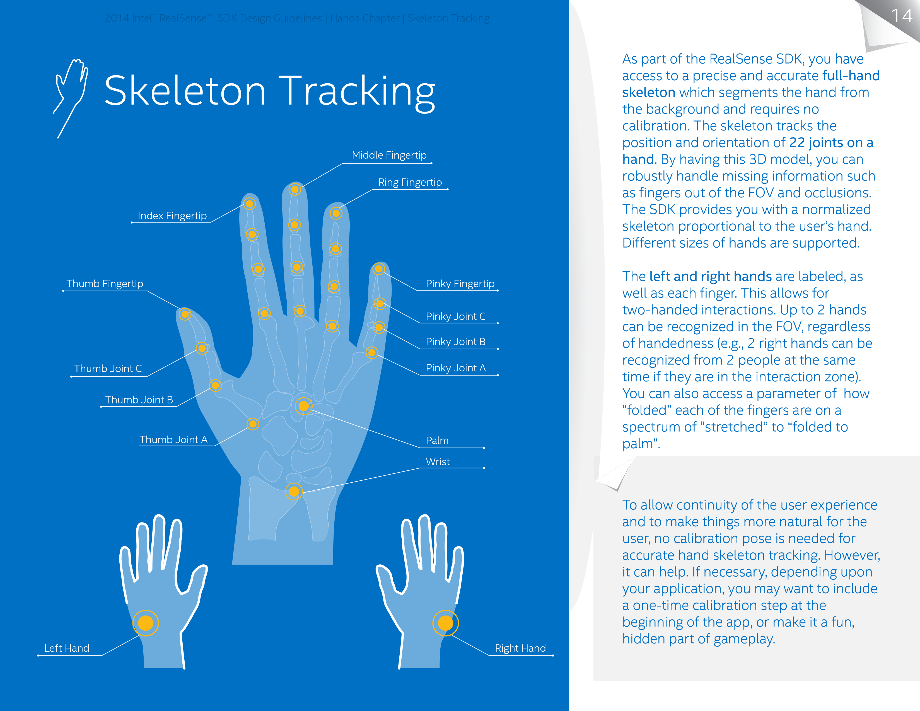
Output: Skeletal
Body-side
Left or right hand side
Palm Orientation
Direction in which the hands palm is facing
Joint Data
22 tracked joints per hand
Position (world and screen space)
Rotation (local and global)
Speed (Velocity of a joint)
Normalized Joints
Best for dealing with joint data distance
Finger Data
Foldedess (0-100 degrees of finger foldedness)
Radius (Pixel radius of finger tips)
Openness
Hand openness 0 = folded and 100 = fully open
Notes:
Mass Center:
The module provides the image and world coordinates of the calculated hand image mass center.
•Extremity Points:
The module provides the most commonly used special tracking points such as the left most point, the right most point of the hand pixels. See the ExtremityType enumerator for the special points and the ExtremityData structure for the extremity point parameters.
Define the boundaries of the hand
Closest point
Top-most
Bottom-most
Left-most
Right-most
World and image coordinates
Do not require full skeleton
Less CPU
•Body Side:
An estimation of whether this is a left hand or a right hand.
•Palm Orientation:
An estimation of where the palm is facing.
•Tracked Joints:
The tracked Joints reflect the position and rotation of the hand in world and image coordinates. See the JointData structure for the joint parameters.
•Normalized Joints:
The normalized joints reflect the posture of the tracked user’s hand, but never change the dimensions of the hand. In other words, the distances between each joint and its parent joint (bone-length) are always the same, and are fixed to those of a standard hand. See the JointData structure for the joint parameters.
•Finger Data:
Label the fingers. See the FingerData structure for finger label parameters.
•Segmentation Image:
This is the rectangle of the boundaries of the hand in the image.
The hand segmentation image is a gray-scale image in which all the hand pixels are “white” (0xff) and all other pixels are “black” (0x00). The resolution of the hand segmentation image is the same as the depth map at the module input.

Slide 25
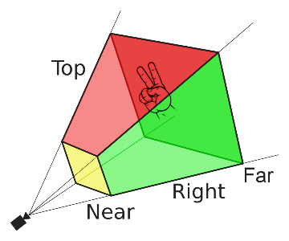
Output: Alerts
Iterate all fired alerts
Test for specific fired alerts
Used to determine if the hand is:
Calibrated
Lost
Present but not tracked
Inside or outside tracking bounds
Alert data:
Label that identifies this alert
The ID of the relevant hand
The time-stamp in which the event occurred
The frame number in which the event occurred
Notes:
ALERT_HAND_OUT_OF_BORDERS
A tracked hand is outside of a 2D bounding box or 3D bounding cube defined by the user.
ALERT_HAND_INSIDE_BORDERS
A tracked hand has moved back inside the 2D bounding box or 3D bounding cube defined by the user.
ALERT_HAND_TOO_FAR
A tracked hand is too far to the camera.
ALERT_HAND_TOO_CLOSE
A tracked Hand is too close to the camera.
ALERT_HAND_DETECTED
A tracked hand is identified and its mask is available.
ALERT_HAND_NOT_DETECTED
A previously detected hand is lost, either because it left the field of view or because it is occluded.
ALERT_HAND_TRACKED
Full or partial tracking information is available for a hand.
ALERT_HAND_NOT_TRACKED
No tracking information is available for a hand (none of the joints are tracked with confidence greater than zero.)
ALERT_HAND_CALIBRATED
The hand measurements are ready and accurate.
ALERT_HAND_NOT_CALIBRATED
The hand measurements are not yet finalized, and are not fully accurate.
ALERT_HAND_OUT_OF_LEFT_BORDER
The tracked object is touching the left border of the field of view.
ALERT_HAND_OUT_OF_RIGHT_BORDER
The tracked object is touching the right border of the field of view.
ALERT_HAND_OUT_OF_TOP_BORDER
The tracked object is touching the upper border of the field of view.
ALERT_HAND_OUT_OF_BOTTOM_BORDER
The tracked object is touching the lower border of the field of view.

Slide 26
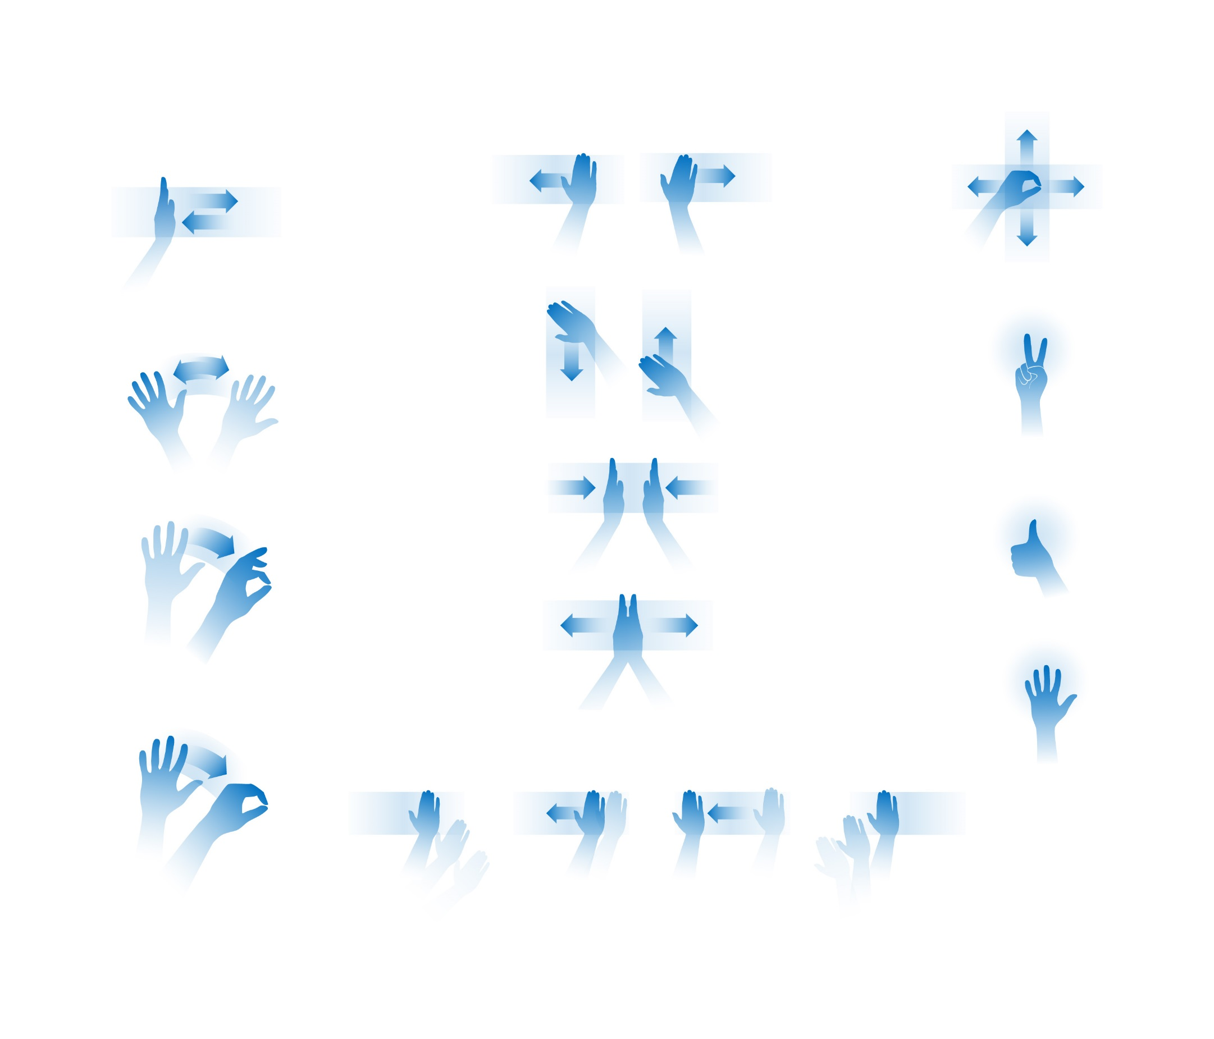


Output: Gestures
Iterate all fire gestures
Test for a specific gesture
Gesture Data
Unique name of the gesture
The ID of the relevant hand
The timestamp in which the event occurred
The frame number in which the event occurred
The gesture state (started, stopped, in progress)

Slide 27
Event Handling

Slide 28
Event Handlers
Action
Polling / Callback
Approach
Implementation
Example
Reaction

Slide 29
Event Handlers: Approach
Only register to interesting / relevant events
E.g. “hand entered the scene”, “user performed the V sign”
Avoids recognition confusion between similar gestures
React only upon event firing
Application can be idle while nothing interesting happens
Callback code is executed in SDK thread
Needs to be short and efficient
Unity base applications cannot execute Unity API in callback
Polling and event-handling can be combined
E.g. polling loop for finger-tip position, callbacks for handling “tap” gesture

Slide 30
Event Handlers: Implementation
Instantiate event handler class
Implement the OnFiredAlert (or OnFiredGesture) method
Handle different events (if required)
Subscribe callback
Registers the callback with the alerts/gestures events
Enable/disable specific events
Start processing loop
Callback activation+
OnFiredAlert / OnFiredGesture method called when a registered event is fired

Slide 31
Event Handlers: Callback
public delegate void OnHandDataDelegate(PXCMHandData.IHand data);
// Use this for initialization
void Start()
{
// Create hand configuration instance, enable and subscribe to all gestures
hcfg = hand.CreateActiveConfiguration();
hcfg.EnableAllGestures();
hcfg.EnableAllAlerts();
hcfg.SubscribeGesture(OnFiredGesture);
hcfg.SubscribeAlert(OnFiredAlert);
hcfg.ApplyChanges();
hcfg.Dispose();
}
/// Receive registered gesture notifications
void OnFiredGesture(PXCMHandData.GestureData data)
{
Debug.Log("Gesture = " + data.name.ToString());
}
/// Receive registered event notifications
void OnFiredAlert(PXCMHandData.AlertData data)
{
Debug.Log("Alert = " + data.label.ToString());
}
void Start()
{
hcfg = hand.CreateActiveConfiguration();
hcfg.EnableGestures(“tap”);
hcfg.EnableAlert(PXCMHandData.AlertType.ALERT_HAND_CALIBRATED);
hcfg.SubscribeGesture(OnFiredGesture);
hcfg.SubscribeAlert(OnFiredAlert);
hcfg.ApplyChanges();
hcfg.Dispose();
}
Alternatively enable only the gestures that will be used
Notes:
Click
Alternatively you can choose to only enable the gestures that will be used, this helps avoid gesture recognition confusion. Again note that similar gestures should be avoided.
Further note: (emphasize): The callback method should be very short and simple. Don't do all the processing, animation, etc, in the callback simply only mark the state changes, and handle them later in the application.

Slide 32
Event Handlers: Polling
PXCMHandData.GestureData gesture_data;
PXCMHandData.AlertData alert_data;
// Update is called once per frame
void Update ()
{
if (sm==null) return;
/* Wait until any frame data is available */
if (sm.AcquireFrame(false,0)<pxcmStatus.PXCM_STATUS_NO_ERROR) return;
hand_data.Update(); // PXCMHandData instance should be a global instance so that it can be access in the callback.
/* Retrieve hand tracking data if ready */
if (hand_data != null)
{
DisplayJoints(hand_data);
if (hand_data.IsAlertFired(PXCMHandData.AlertType.ALERT_HAND_CALIBRATED, out alert_data))
{
Debug.Log("Hand calibrated");
}
if(hand_data.IsGestureFired("tap", out gesture_data))
{
Debug.Log("Tap gesture fired");
}
}
/* Release current frame so we can process the next frame */
sm.ReleaseFrame();
}
Listen to one or all events
Constantly checking to determine if an alert /gesture event has been raised.
Used for motion gestures such as pinch and drag
Unity base applications cannot execute Unity API in callback polling easier but at the expense of time.
Alternative:
Polling and event-handling combined (polling position, callback on “tap”)
Notes:
/// Callback runs on a separate SDK thread so Unity specific API calls cannot be made inside the callback function

Slide 33
Tracking Modes

Slide 34
Tracking: Skeletal
Avoid
Using blob + skeletal tracking together (Skeletal provides extremity tracking)
Strong occlusion of hands, I.E hand behind object
Hands near the face, or other object
Hands near the camera field of view edge
The use the unnecessary joints (don’t query if not needed)
Accuracy deteriorates frame rate below 50 fps. (depth stream >= 60 fps. )
Roll your own gestures
Track specific joints to create new gesture like interaction (pinch, grab, etc.)
Avoid unnecessary CPU cost only subset of the 22 joints
Combination of Joint Gesture tracking:
Tracking center hand position as pointer
Execute / select command with recognized gesture (fist, tap, etc.)
Notes:
Avoid
Using blob + skeletal tracking together (Skeletal provides extremity tracking)
Strong occlusion of hands, I.E hand behind object
Hands near the face, or other object
Hands near the camera field of view edge
The use the unnecessary joints (don’t query if not needed)
Accuracy deteriorates frame rate below 50 fps. (depth stream >= 60 fps. )
Roll your own gestures
Track specific joints to create new gesture like interaction (pinch, grab, etc.)
Avoid unnecessary CPU cost only subset of the 22 joints
Combination of Joint Gesture tracking:
Tracking center hand position as pointer
Execute / select command with recognized gesture (fist, tap, etc.)

Slide 35
Tracking: Overview
Tracking Mode | Hand only? | Outputs | Computational resources | Limitations
Full Hand | Yes | Segmentation image, extremity points, hand side, alerts, joints info, fingers info, openness, gestures | Highest, multiple threads | 2 hands, 60 cm range, slower hand speed
Extremities | Yes | Segmentation image, extremity points, hand side, alerts | Medium, single thread | 2 hands, 60 cm range, medium hand speed
Blob | No | Segmentation image, extremity points, contour line | Low, single thread | 4 objects, 100 cm range, fast speed
Tracking palm minimum width should be at least 5.5 cm
VGA (640x480) depth image resolution, up to 0.75m/s.
HVGA (640x240) depth image resolution, up to 2m/s.
Optimal frame rate for the depth stream is 60 fps. Hand tracking accuracy may deteriorate for a frame rate below 50 fps.

Slide 36
Tracking: Skeletal Code
void Update ()
{
if (sm==null) return;
/* Wait until any frame data is available */
if (sm.AcquireFrame(false,0)<pxcmStatus.PXCM_STATUS_NO_ERROR) return;
if (hand_data != null)
{
hand_data.Update();
int numOfHands = hand_data.QueryNumberOfHands(); /* Query the number of tracked hands*/
for (int i = 0; i < numOfHands; i++)
{
/* Get hand by time of appearence */
if (hand_data.QueryHandData(PXCMHandData.AccessOrderType.ACCESS_ORDER_BY_TIME, i, out handData) == pxcmStatus.PXCM_STATUS_NO_ERROR)
{
Debug.Log(handData.QueryBodySide()); /* print this hand bodyside */
for (int j = 0; j < PXCMHandData.NUMBER_OF_JOINTS; j++) /* Query tracked joints*/
{
/* Return the tracked joint data for a specific joint*/
handData.QueryTrackedJoint((PXCMHandData.JointType) j, out jointData);
/* Print this joints world position */
Debug.Log(jointData.positionWorld);
}
}
}
hand_data.Dispose();
}
}

Slide 37
Tracking: Extremities
Avoid
Using blob + skeletal tracking together (data is similar unnecessary overhead)
Strong occlusion of hands
Hands near the face
Hands near the camera field of view edge
The use the unnecessary joints (don’t query if not needed)
Accuracy deteriorates frame rate below 50 fps. (depth stream >= 60 fps. )
Roll your own gestures
Track specific joints to create new gesture like interaction (pinch, grab, etc.)
Avoid unnecessary CPU cost only subset of the 22 joints
Combination of Joint Gesture tracking:
Tracking center hand position as pointer
Execute / select command with recognized gesture (fist, tap, etc.)
New with R2 – need more information

Slide 38
Tracking: Extremities Code
void Update ()
{
if (sm==null) return;
/* Wait until any frame data is available */
if (sm.AcquireFrame(false,0)<pxcmStatus.PXCM_STATUS_NO_ERROR) return;
if (hand_data != null)
{
hand_data.Update();
int numOfHands = hand_data.QueryNumberOfHands(); /* Query the number of tracked hands*/
for (int i = 0; i < numOfHands; i++)
{
/* Get hand by time of appearence */
if (hand_data.QueryHandData(PXCMHandData.AccessOrderType.ACCESS_ORDER_BY_TIME, i, out handData) == pxcmStatus.PXCM_STATUS_NO_ERROR)
{
Debug.Log(handData.QueryBodySide()); /* print this hand bodyside */
for (int j = 0; j < PXCMHandData.NUMBER_OF_JOINTS; j++) /* Query tracked joints*/
{
/* Return the tracked joint data for a specific joint*/
handData.QueryTrackedJoint((PXCMHandData.JointType) j, out jointData);
/* Print this joints world position */
Debug.Log(jointData.positionWorld);
}
}
}
hand_data.Dispose();
}
}
New to R2- create sample code

Slide 39
Tracking: Gesture
Discrete Gesture notification:
Start event received once a pose is recognized
End event received once that pose is no longer performed
Each gesture has it’s own notification
Stability issue with motion may result in false positive (fist/pinch) or fail recognition
Continuous Gesture notification:
Will receive an “In-progress” event while the pose is performed
Stability issue with motion may result in false positive (fist/pinch) or fail recognition
Be thoughtful:
Avoid false positives by avoid similar gestures and only enable ones that will be used.
Gestures recognition makes use of pose estimation, motion effects recognition quality
Use gestures that are intuitive, and avoid the use of gestures that increase fatigue

Slide 40
Tracking: Gesture Code
void Update ()
{
if (sm==null) return;
if (sm.AcquireFrame(false,0)<pxcmStatus.PXCM_STATUS_NO_ERROR) return;
if (hand!=null)
{
hand_data.Update();
if(hand_data.IsGestureFired(“tap", out gesture_data))
{
if(gesture_data.state == PXCMHandData.GestureStateType.GESTURE_STATE_IN_PROGRESS)
{
Debug.Log("Tap in progress from hand ID " + gesture_data.handId.ToString());
}
if(gesture_data.state == PXCMHandData.GestureStateType.GESTURE_STATE_END)
{
Debug.Log("Tap ended from hand ID " + gesture_data.frameNumber.ToString() + "at frame " + gesture_data.frameNumber.ToString());
}
}
PrepareJoints(hand_data);
}
sm.ReleaseFrame();
}
Example of gesture callback on slide 25

Slide 41
Blob Module

Slide 42
Configuration: Blob
Member Function | Description
EnableSegmentationImage | Enable/disable the extraction of the segmentation image. Set to true by default.
EnableContourExtraction | Enable/disable the extraction of contour lines. Set to true by default.
SetMaxBlobs | Set the maximal number of blobs to be detected. The largest blobs are extracted first. The default is 1.
SetMaxDistance | Set the maximal distance in millimeters from the sensor, where objects (blobs) are to be identified. Default distance is 550mm (~1.8ft/ 0.54m)
SetMinPixelCount | Set the minimal number of pixels that a blob must have. Objects with less pixels are not identified as blobs.
SetMinContourSize | Set the minimal contour points for an object. Any blob with fewer contour points will not be identified.
EnableSegmentationImage | Enable/disable the extraction of the segmentation image. Set to true by default.
EnableContourExtraction | Enable/disable the extraction of contour lines. Set to true by default.
SetMaxBlobs | Set the maximal number of blobs to be detected. The largest blobs are extracted first. The default is 1.
Notes:
Here we take a look at configuration properties to customize blob tracking
EnableSegmentationImage
Enable/disable the extraction of the segmentation image. Set to true by default.
EnableContourExtraction
Enable/disable the extraction of contour lines. Set to true by default.
SetMaxBlobs
Set the maximal number of blobs to be detected. The largest blobs are extracted first. The default is 1.
SetMaxDistance
Set the maximal distance in millimeters from the sensor, where objects (blobs) are to be identified. 550mm
SetMinPixelCount
Set the minimal number of pixels that a blob must have. Objects with less pixels are not identified as blobs.
SetMinContourSize
Set the minimal contour points for an object. Any blob with fewer contour points will not be identified.
EnableSegmentationImage
Enable/disable the extraction of the segmentation image. Set to true by default.
EnableContourExtraction
Enable/disable the extraction of contour lines. Set to true by default.
SetMaxBlobs
Set the maximal number of blobs to be detected. The largest blobs are extracted first. The default is 1.

Slide 43
Tracking: Blob
Blob Extractor
Blob extraction is based on the depth measurement
Retrieve the mask (segmentation image) of any blob in front of the camera
Detects any object within predefined range (adjustable)
Does NOT look for hands
Blobs will be ordered by their size (number of pixels in mask).
Ignores small objects/noise (adjustable)
Limited to two objects
Allows smoothing of the mask
Input buffer can be provided as color or depth.
Blobs tracking is not lost due to hand orientation
Contour Extractor
Extracts the line (list of points) defining a blob’s borders
Returns both external line (CCW order) and internal ones (CW order)
Allows smoothing of the line (reduces the number of points)
Input buffer can be either color or depth.
BLOB | Member | Output Data Descriptions
 | closestPoint | The image coordinate of the closest blob point
 | leftPoint | The image coordinate of the left-most blob point
 | rightPoint | The image coordinate of the right-most blob point
 | topPoint | The image coordinate of the top point of the blob.
 | bottomPoint | The image coordinate of the bottom point of the blob.
 | centerPoint | The image coordinate of the center point of the blob.
 | PixelCount | The number of pixels in the blob.
CONTOUR | Member | Output Data Descriptions
 | Index | The zero-based contour index.
 | maxSize | The number of contour points allocated.
 | Contour | The array of contour points, to be returned.
Notes:
Don’t use blob and skeletal tracking together
The blob extractor provides information about image blobs within certain depth value range.
Blob detection range is adjustable. The Depth value range is the max depth to accept blobs and the max depth of the blob itself
Input buffer can be provided as color or depth.
Don’t use blob and skeletal tracking together
Blob extraction is based on the depth measurement
The blob extractor provides information about image blobs within certain depth value range.
Depth value range is the max depth to accept blobs and the max depth of the blob itself
Input buffer can be provided as color or depth.

Slide 44

Output: Blob
Mass-Center
Position (world and screen space)
Extremity Points
Basic extremity points (top, left, etc.)
Position in world and screen space
Less CPU intensive
Segmentation
2D image mask of tracked hand
Bounds
2D rect defining the boundary of the hand mask

Slide 45
Output: Contour
Mass-Center
Position (world and screen space)
Extremity Points
Basic extremity points (top, left, etc.)
Position in world and screen space
Less CPU intensive
Segmentation
2D image mask of tracked hand
Bounds
2D rect defining the boundary of the hand mask
Place contour output data on this slide

Slide 46
Tracking: Blob Data
/* Create an instance of the PXC[M]Image interface to manage image buffer access. */
new_image = mask_utils.PipelineManager.session.CreateImage(info);
/* Perform blob extraction on the specified depth image.*/
results = m_blob.ProcessImage(sample.depth);
int numOfBlobs = m_blob.QueryNumberOfBlobs();
if (results == pxcmStatus.PXCM_STATUS_NO_ERROR && numOfBlobs > 0)
{
for (int j = 0; j < numOfBlobs; j++)
{
/* Query Blob data*/
results = m_blob.QueryBlobData(j, new_image, out blobData[j]);
if (results == pxcmStatus.PXCM_STATUS_NO_ERROR)
{
Debug.Log("Blob center point = " + blobData[j].centerPoint.x.ToString() + ", " + blobData[j].centerPoint.y.ToString());
/* The AcquireAccess function locks the image buffer for exclusive access. If the specified pixel format is not available for the image storage */
results = new_image.AcquireAccess(PXCMImage.Access.ACCESS_READ_WRITE, PXCMImage.PixelFormat.PIXEL_FORMAT_RGB32, out new_bdata[j]);
if (results == pxcmStatus.PXCM_STATUS_NO_ERROR)
{
/* convert raw pixel data to unity specific texture data*/
new_bdata[j].ToTexture2D(0, texture[j]);
/*apply texture to material*/
mat[j].mainTexture = texture[j];
texture[j].Apply();
}
new_image.ReleaseAccess(new_bdata[j]);
}
}
}
Notes:
Don’t use blob and skeletal tracking together
The blob extractor provides information about image blobs within certain depth value range.
Blob detection range is adjustable. The Depth value range is the max depth to accept blobs and the max depth of the blob itself
Input buffer can be provided as color or depth.
Don’t use blob and skeletal tracking together
Blob extraction is based on the depth measurement
The blob extractor provides information about image blobs within certain depth value range.
Depth value range is the max depth to accept blobs and the max depth of the blob itself
Input buffer can be provided as color or depth.

Slide 47
Tracking: Contour
/* Create an instance of the PXC[M]Image interface to manage image buffer access. */
new_image = mask_utils.PipelineManager.session.CreateImage(info);
/* Perform contour extraction on the specified depth image*/
results = m_contour.ProcessImage(new_image);
if (results == pxcmStatus.PXCM_STATUS_NO_ERROR && m_contour.QueryNumberOfContours() > 0)
{
/* Retrieve the detected contour points.*/
results = m_contour.QueryContourData(0, out pointOuter[j]);
if (results == pxcmStatus.PXCM_STATUS_NO_ERROR)
{
for (int i = 0; i < numOfBlobs; i++)
{
/* Set contour pixels to texture*/
for (int j = 0; j < pointOuter.Length; j++)
{
texture[i].SetPixel((int)pointOuter[j].x, (int)pointOuter[j].y, Color.blue);
}
texture[i].Apply();
}
}
new_image.ReleaseAccess(new_bdata[j]);
}

Slide 48
Utilities: Data Smoothing
Allows smoothing of most data stream
Supports 1D, 2D, and 3D data vectors
Supports different smoothing methods:
Stabilizing Smoother
Keeps existing location unless a large movement was detected
Best for UI interaction, acts like a gravity well / magnetic field
Weighted
Allows averaging the data according to any set of weights (e.g. uniform, Gaussian)
Recommended for smoothing of hand, blob, contour data.
Quadratic
Time based, acts both as stabilizer and smoother
Spring
Time based, linear affect on the data

Slide 49
Utilities

Slide 50
Utilities: Smoothing Initialization
Initialize
private PXCMHandData.JointData[][] jointData; //non-smooth joint values
private PXCMDataSmoothing ds = null; //Smoothing module instance
private PXCMDataSmoothing.Smoother3D[][] smoother3D = null; //smooth joint values
private int weightsNum = 4; //smoothing factor
// Use this for initialization
void Start()
{
//... extraneous pipeline initialization details omitted
/* Retrieve the Data Smoothing instance */
sm.QuerySession().CreateImpl<PXCMDataSmoothing>(out ds);
/* Create a 3D Weighted algorithm */
smoother3D = new PXCMDataSmoothing.Smoother3D[MaxHands][];
for (int i = 0; i < MaxHands; i++)
{
smoother3D[i] = new PXCMDataSmoothing.Smoother3D[MaxJoints];
for (int j = 0; j < M
MaxJoints; j++)
{
smoother3D[i][j] = ds.Create3DWeighted(weightsNum);
}
}
}
Steps:
Create an instance of the smoothing interface
Create a weighted smoothing instance
Notes:
The recommendation is always to use which smoother fits best and in general find the sweet spot for the application by adjusting the parameters of the various smoothing methods.
due to a known issue, the influence of different smoothing values varies a lot in different smoother options.
users are encouraged to experience different algos and values before deciding
we have improved this in R2 and created a new simpler smoother

Slide 51
Utilities: Smoothing Processing
Process
//Smoothen and Display the Joint Data
void ManageJoints()
{
//... extrenous data query details omitted
/* Apply smoothing to the acquired data */
for (int i = 0; i < MaxHands; i++)
{
for (int j = 0; j < MaxJoints; j++)
{
if (jointData[i][j] != null && jointData[i][j].confidence == 100)
{
smoother3D[i][j].AddSample(jointData[i][j].positionWorld);
Vector3 inverted = new Vector3(-1 * smoother3D[i][j].GetSample().x, smoother3D[i][j].GetSample().y, smoother3D[i][j].GetSample().z) * 100f;
myJoints[i][j].transform.position = new Vector3(inverted.x, inverted.y, inverted.z) * 100f;
}
}
}
}
Steps:
Add data point to be smoothed
Get the smoothed data point

Slide 52
Utilities: Smoothing Dispose
Dispose
//Close any ongoing Session
void OnDisable()
{
if (smoother3D != null)
{
for (int i = 0; i < MaxHands; i++)
{
if (smoother3D[i] != null)
{
for (int j = 0; j < MaxJoints; j++)
{
smoother3D[i][j].Dispose();
smoother3D[i][j] = null;
}
}
}
smoother3D = null;
}
}
Steps:
Clean up

Slide 53
Best Practices

Slide 54
Best Practices: When to apply
Contour Mode (BlobExtractor)
Lowest CPU usage, single thread
Not hand specific. Will detect any object
Basic info (inner and outer contour points, mask, extremity points)
Extemities Tracking
Higher CPU usage, still single thread
hand specific
Basic info (mask, extremity points, hand-side)
1.0 m/s max blob tracking speed
Full Skeleton Tracking
Highest CPU usage, two threads
Detects only hands (may fail on difficult scenarios)
Basic Info (Full hand, finger, and joint information)
0.75 m/s max joint tracking speed

Slide 55
Best Practices: Motion
Buffered Field of View: Avoid hands moving out of view by narrowing the field of view, you’ll get the alert before the hand actual goes out of bounds while tracking data is still good. This also allow developers to get an early warning when the users hand is going out of bounds.
Joint over gesture swipe: Rather than swipe gestures, use hand joint position (vector) to determine direction, add a cool down timer between swipes to avoid having excessive swiping when the user does not intend to swipe.
Adaptive Field of View: Create an adaptive field of view (must be hand rolled, will be released in the future, but is in the toolkit). This is where you map the area around the hand to the screen space. Smaller movements can then be used to reach either side of the screen.

Slide 56
Best Practices: Configuration
Get Calibration notice: Register for alerts, make sure the hand has been calibrated before attempting to track. Can be done as either a continuous check or an callback. Lost hand re-enter no calib event?
Normalize your joints: Normalize skeleton tracked data of joints so that regardless of hand size the joint data is scale to the same size for different hands. The benefit is that custom gestures that rely on distance between joints will work regardless of hand size.
Configure for blob tracking: Issue has been seen where Thumbs up blob tracking treats the thumb and hand as separate blobs, This is a camera depth setting issue. Configure blob tracking correctly by specifying a virtual wall (threshold on the camera the far plane), which is the max depth at which to accept blobs. Also specify the depth of the blob itself as to avoid tracking the forearm when only the hand is required, or cutting off the blob.

Slide 57
Best Practices: Tracking
Blob over Joint tracking: If joint tracking is not necessary use blob tracking as blobs are not lost due to orientation as joint tracking is. Also, for performance considerations always prefer blob over skeletal tracking where possible.
Blob tracking ordered by size: Bob tracking order only has one access order from largest to smaller. Roll your own solution for tracking left and/or right blob. Suggestion is to use world space positions of blobs to determine left or right hand side blob location.
Blob Alert: Blob tracking does not provide out of bounds alerts. Can query camera bounds and use blob bounds to determine if the blob is within the camera field of view. Alternatively using the screen coordinates one can determine if the blob intersects the screen edge
Discrete vs Continuous recognition: Hand events are either discrete or continuous. This means that gestures start and stop or gesture are either on or off
Configure the camera for the appropriate experience: HVGA capture mode is for faster motions and should be used if the user is expected to do faster tracking, but at a shorter range and the expense of quality. The opposite is true for VGA.

Slide 58
Best Practices: Interface
Model with natural motion: It’s more natural to pivot the elbow for navigation than having the user move the arm from left to right, provide a natural arc for menu navigation and design this into the menu flow.
Combination of modes to achieve better results: Separate the detection of the x, y, z coordinate and roll your own tap gesture. For example, map coordinates to different joint, such as x, y to the wrist or palm center and z to a finger. This approach provides smoother tracking and movement in x, y and more data in the z direction for back and forth tapping movement.
Smoothing Interface interaction: UI interaction should make use of Gravity well / Magnetic fields for selection. Provides easy smooth menu interaction, UX studies indicate that users do not notice when the hand is magnetically snapped to the area in which they wanted/intended to move.
Fail gracefully! If you provide visual tracking information (such as an animated hand) to illustrate the tracked, don’t show failure, instead fade / disable visuals.

Slide 59
Backup

Slide 60
Gesture Training: Agenda
Hand Module
Structure
Initialization
Processing Loop
Configuration
General
Gestures
Tracking
Alerts
Output
General
Hand data
Joint data
Finger data
Extremity Points
Event handlers
Implementation
Callback
Polling
Tracking Modes
Polling Skeletal
Gesture
Blob Module
Best Practices

Slide 61
Requirements

Slide 62
Requirements
Hardware:
4Th Generation Intel® Core™ processor based on Intel microarchitecture code name Haswell
8GB free hard disk space
Intel® RealSense™ 3D camera (requires USB 3 port)
Software
Microsoft Windows 8.1 OS 64-bit
Microsoft Visual Studio 2010-2013 with latest service packs
Microsoft .Net 4.0 Framework for C# development
Unity Pro 4.1 or higher for Unity integration and development
Any of the following browsers for JavaScript development
Microsoft Internet Explorer 10.0.13
Google Chrome 33.0.1750.146
Mozilla Firefox 27.0.1
Processing 2.1.2 or higher for Processing development
Java JDK 1.7.0_11 or higher for Java development
Notes:
Configuration
ApplyChanges()
RestoreDefaults()
Update()
output
Update

